Slide 1
moose for dcs world close air support

Slide 2
AI_CAS_ZONE
At the end of
each patrol route.
At the end of
each engage route.
None
Start
Patrolling
Route
Engage
Engaging
*
Accomplish
Destroy
Abort
Status
Detect
*
Detected
RTB
RTB

Slide 3
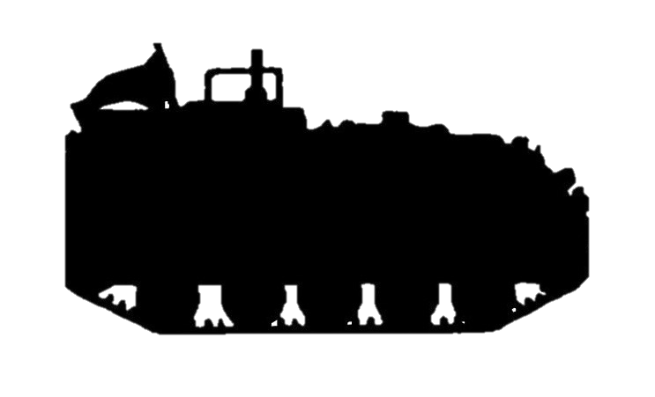
a process that holds the ai in a patrol zone and engages the ai in an engage zone.
AI_CAS_ZONE engages the
targets in the Engagement
Zone when commanded
to Engage.
3
AI_CAS_ZONE holds
the AI assigned with
Close Air Support
in the Patrol Zone until
commanded to Engage.
AIRBASE 1
ENGAGE ZONE
PATROL ZONE
AIRBASE 4

Slide 4
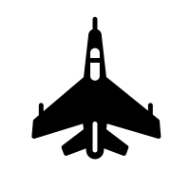
a process that needs to be started.
Start the
AI_CAS_ZONE
Processs
3
Start
AIRBASE 1
ENGAGE ZONE
PATROL ZONE
AIRBASE 4
AI

Slide 5
routes the AI to random points in the patrol zone.
The AI
is assigned a
random point in the
Patrol Zone
AIRBASE 1
ENGAGE ZONE
Route
AIRBASE 4
PATROL ZONE
AI

Slide 6
routes the ai to random points in the engage zone when engage.
The AI
is commanded to Engage.
It will fly to the Engage Zone
and will detect Targets.
AIRBASE 1
Engage
ENGAGE ZONE
PATROL ZONE
AIRBASE 4
AI

Slide 7
only targets in the engage zone will be engaged.
The AI
is Engaging the Targets.
Only those Targets within
the Engagement Zone will
be Engaged!
AIRBASE 1
AI
ENGAGE ZONE
PATROL ZONE
AIRBASE 4

Slide 8
targets destroyed are reported.
Each Target destroyed within the
Engage Zone will trigger a
Destroy event in AI_CAS_ZONE,
bearing the UNIT that was
destroyed.
Destroy
AI
AIRBASE 1
ENGAGE ZONE
PATROL ZONE
AIRBASE 4

Slide 9
ai does not know the targets, so it keeps looking for them…
When all Targets are Destroyed,
the AI_CAS_ZONE will keep on
Engaging, searching for targets.
Engage
AIRBASE 1
AI
ENGAGE ZONE
PATROL ZONE
AIRBASE 4

Slide 10
accomplish the cas task through external observers or timers etc.
Another entity will have to
command the AI that
the CAS is Accomplished.
Accomplish
AIRBASE 1
AI
AI
ENGAGE ZONE
PATROL ZONE
AIRBASE 4

Slide 11
when accomplished, fly back to the patrol zone…
When the CAS
is accomplished, then
the AI will fly back to the
Patrol Zone.
3
Route
AIRBASE 1
AI
ENGAGE ZONE
PATROL ZONE
AIRBASE 4

Slide 12
rtb when out of fuel or when commanded to fly home.
When out of fuel,
the AI will fly
back home.
The AI can also be
commanded to fly home.
3
AIRBASE 1
RTB
PATROL ZONE
AIRBASE 4
AI

Slide 13
moose for dcs world close air support cas-001 – AI cas zone basic scenario

